Slide 1

Career Planning
Computing
Delivered by – Marlene Vassell

Slide 2

Today’s Session
Learning Objectives
DEVELOP
Review the development of your skills and experience.
Evidence your skills and experience using STAR.
Set goals to further develop your skills and experience.

Slide 3



Do not edit How to change the design
You’re working in a busy restaurant. One evening, a large booking arrives unexpectedly, and the kitchen is short-staffed. You help reorganise tables, take extra orders, and keep customers calm while the team catches up. What skills did you use?
The Slido app must be installed on every computer you’re presenting from
Notes:
1. Teamwork & Collaboration
You stepped outside your usual duties to support the kitchen and front-of-house staff, working together to manage the sudden pressure.
⭐ 2. Problem-Solving
You quickly figured out how to reorganise tables, manage workflow, and adjust to the unexpected situation.
⭐ 3. Communication Skills
You kept customers informed and calm, managing expectations clearly and professionally.
⭐ 4. Customer Service
You provided reassurance, addressed concerns, and ensured guests still had a positive experience despite delays.
⭐ 5. Time Management
You balanced multiple tasks—seating guests, taking orders, assisting the team—while staying efficient.
⭐ 6. Adaptability / Flexibility
You responded quickly to an unplanned situation, adjusting your role to meet the immediate needs of the business.
⭐ 7. Stress Management
Even under pressure, you stayed composed, which helped maintain a positive environment for both customers and colleagues.
⭐ 8. Leadership (even without a title)
You took initiative, organised people, and guided the situation forward until the kitchen caught up.

Slide 4

Structuring your examples
using the STAR Technique
The STAR technique will help you to develop answers for applications forms and answering interview questions.
Situation - Where were you?​ Context!
Task - What did you have to do?​
Actions - How did you do it?​ Be specific!
Results - What were the results?

Slide 5
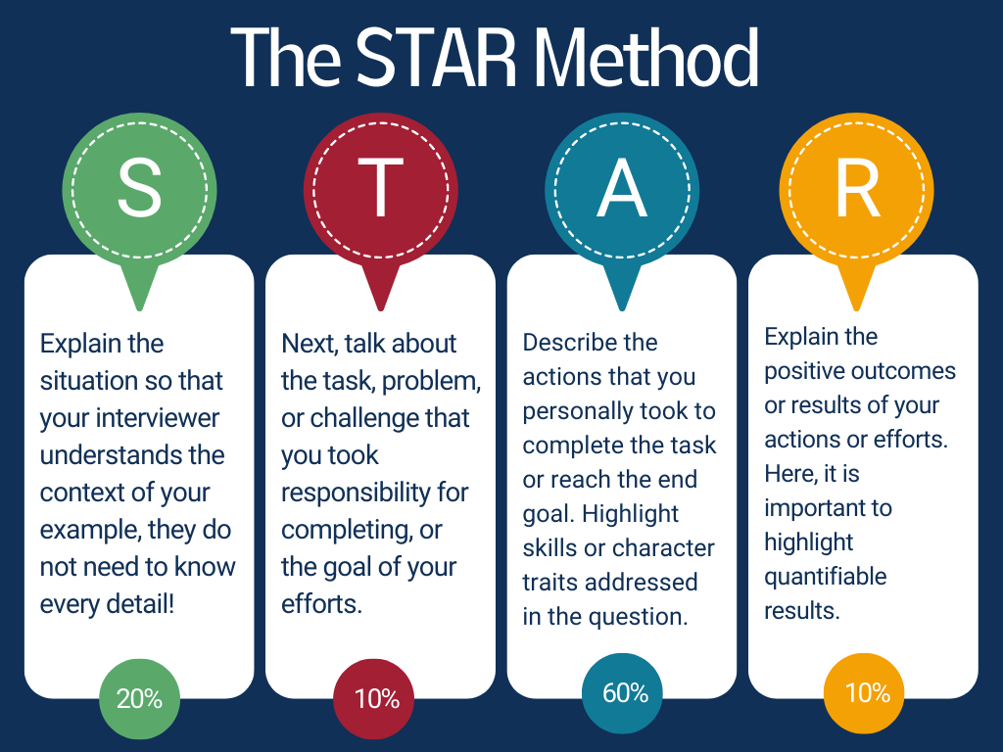
Using the STAR Technique

Slide 6




Competency Questions
​What skills/competencies do employers recruit for?
Problem solving
Planning and organisation
Teamwork
Written communication
Communication/presentation skills
Digital literacy
Creativity/initiative
Tell me about a time when …?
When did you last ….?
Give an example of when you demonstrated…?
Notes:
9

Slide 7

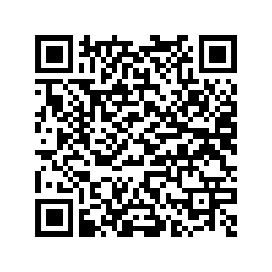

Review the development of your skills
Notes:
Employers have identified the key qualities they look for in individuals when recruiting. Use this audit to consider which skills you have experience in an those you still need to develop. If you need ideas check out the Careers+ website or make an appointment with a careers coach.
Skill areas: problem solving / decision making, planning an organising, teamwork, written communication, verbal communication / presentation skills, digital literacy, creativity / initiative.

Slide 8

The Benefits of Work Experience
Developing skills (and STAR examples)
Exploring options
Building contacts and networks (also in the toolkit)
Sampling jobs
‘Foot in the door’ to further opportunities
Developing commercial awareness/sector knowledge
Building confidence
Finding out about potential future graduate job opportunities
Strengthening your CV/future job applications

Slide 9










Preparing to apply

Slide 10
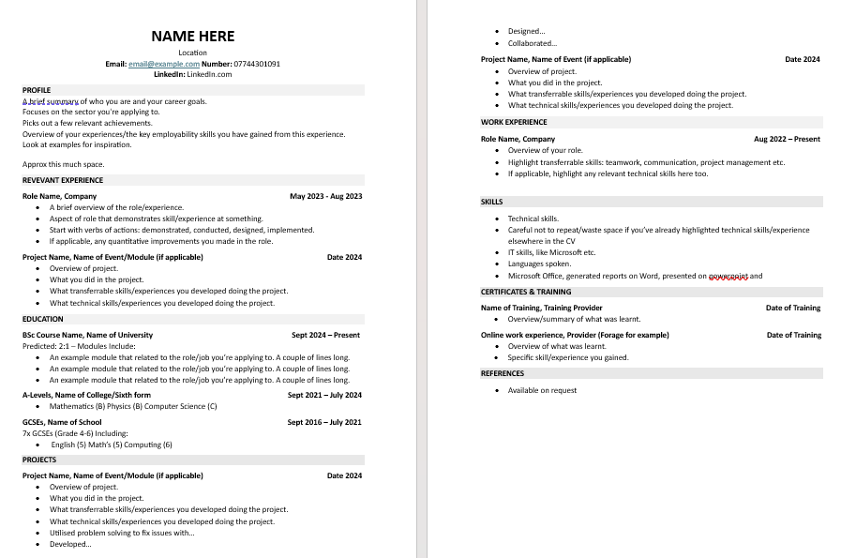

Slide 11
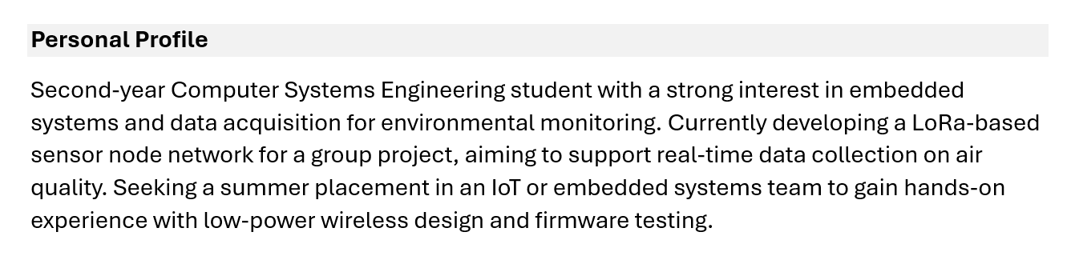

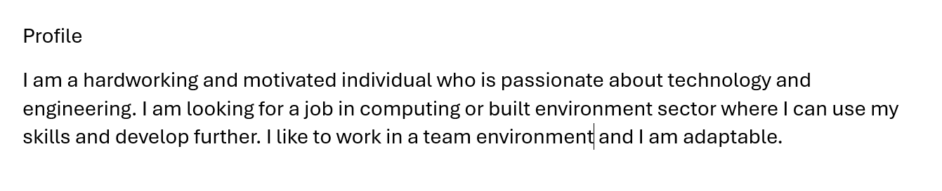
Which is the better Profile section?
Why is it better?
Example 1
Example 2
Notes:
Update profile examples
20

Slide 12
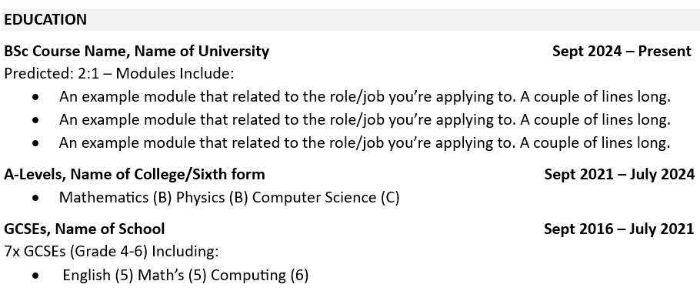
What makes a good education section?

Slide 13
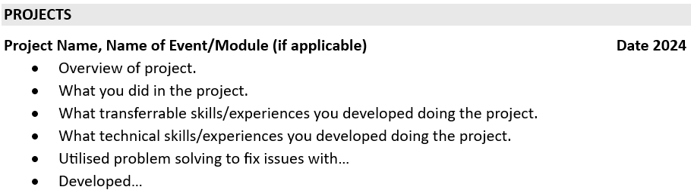
What makes a good project section?

Slide 14

What are psychometric tests?
Psychometric tests are structured methods used by employers to assess a candidate’s suitability for a job (placements, internships, etc.)
Recruiters should identify tests which are appropriate to the job role​
Timed or untimed​
Format can be ‘right or wrong’ or subjective answers which are matched against an ideal candidate profile
Types of tests that you might encounter: ​
Numeracy, logical reasoning, verbal reasoning​
Situational judgement​
Personality

Slide 15
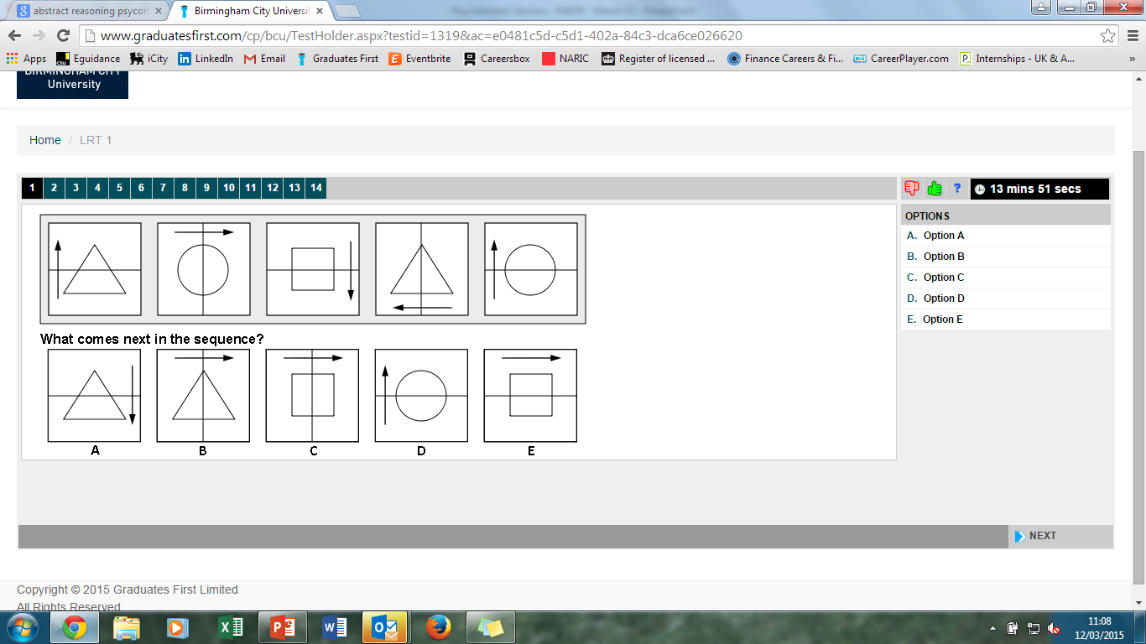
Let’s Try One
Notes:
8
This is a pattern or sequence based question - which tile from the bottom row should come next in the sequence on the top row?
Ask student to shout out answers.
ANSWER: C
Ask students why its C? They must notice everything about the pattern which includes…direction of arrow, shape, direction of line
This is question 1 of 14 (you can see numbers across the top). They start easy and then get progressively harder.
Note the timer in top right corner – 14ms to answer 14 questions. If you do the math this gives your roughly 60 seconds for each question… and as said before they get harder so remember to work quickly & accurately.

Slide 16
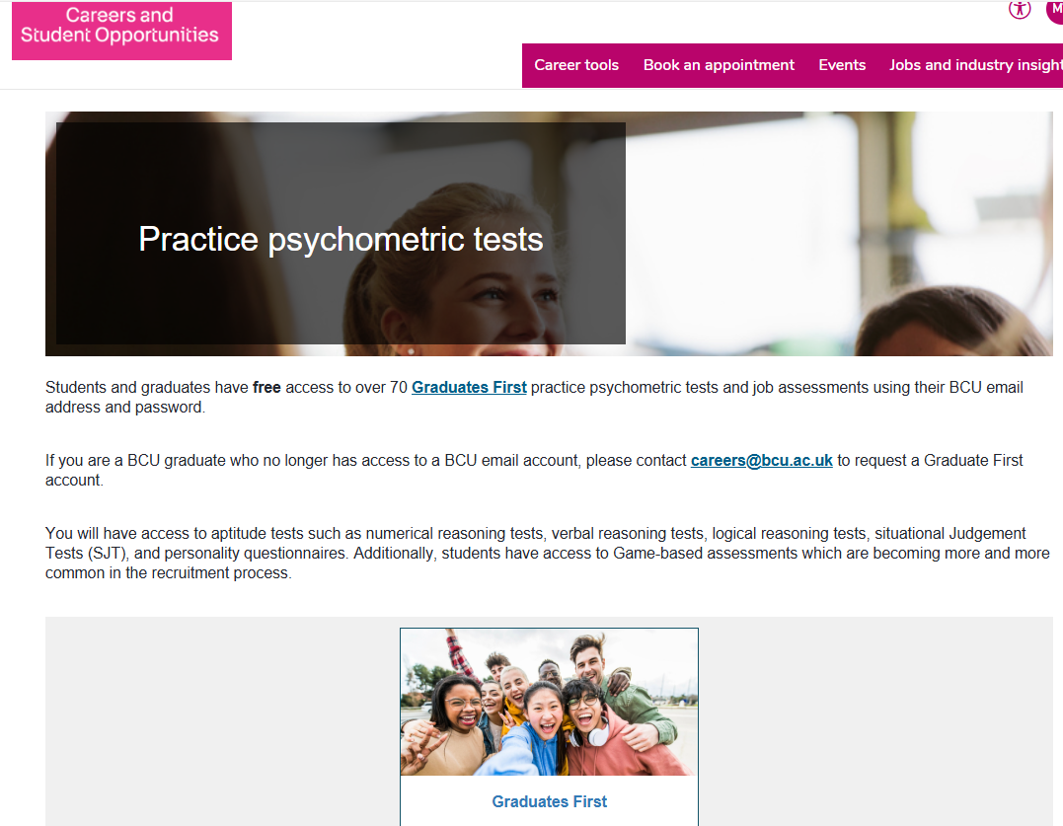
Access FREE Practice Tests
Go to Careers+ Website: Psychometric Page - click on Graduates First
Notes:
Update slide for GradFirst
27

Slide 17

Different routes in your sector
In addition to work experience, you can explore your career options in various ways..

Slide 18
What can you do extra?
Build real projects outside class (apps, cyber labs, networks, dashboards) and document them properly.
Use GitHub consistently to store code, reports, and READMEs that explain what you built and why.
Practice on industry platforms (TryHackMe, Hack The Box, Cisco Packet Tracer, Docker, Power BI, SQL).
Create a home lab (cyber, networking, or systems) to gain hands-on technical experience.
Earn 1–2 relevant entry-level certifications (e.g., CompTIA, Azure Fundamentals, ISC2 CC).
Join hackathons, CTFs, or group projects to show teamwork and problem-solving skills.
Develop a professional online presence (LinkedIn, GitHub, optional portfolio website).
Learn to explain your work clearly—problem, solution, tools used, and improvements.
Notes:
1.7.2013
Any questions?
Tell us what you think...
QR code needs amending/updating
‹#›

Slide 19




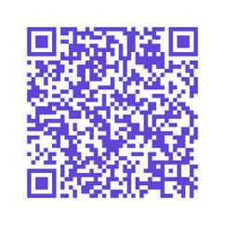
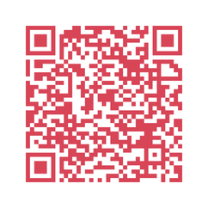
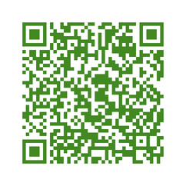
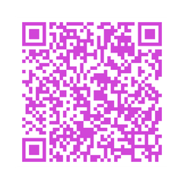
Forage
Virtual Work Experience Opportunities
Scan the QR code to get started
Computing
Engineering
Built Environment
Architecture
No Applications or Experience required!
Learn direct from Leading companies and gain valuable careers skills

Slide 20
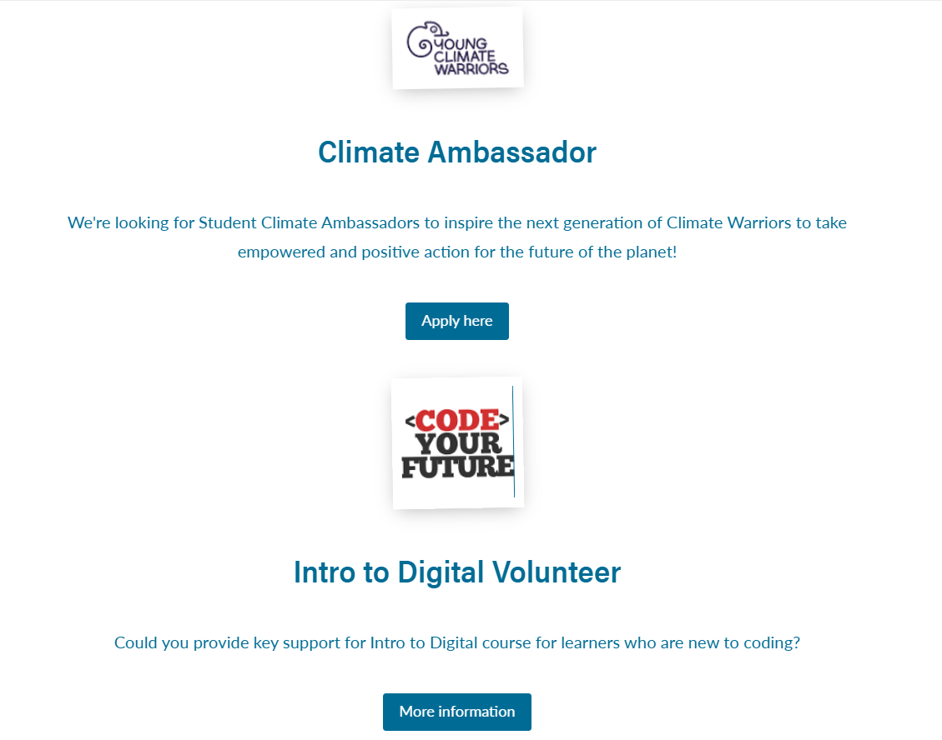



Volunteering
Volunteering
Bulletin
Notes:
Encourage students to think more broadly than the usual non-grad sites like indeed and total jobs. Also consider industry-based jobsites/industry bodies and careers+ jobs portal. Mention that careers+ have industry-based jobsite listings on the website.
3

Slide 21


Go Abroad Opportunities
What’s available
Study abroad (Semester or Full Year)
Work placements abroad (14+ days)
Summer programmes (study, volunteering, internships)
Destinations
Wide range depending on course
Destination videos available on Moodle
Funding
Turing Scheme funding available
Basic funding for all eligible students
Top-ups for WP students
Amount depends on destination, duration & country tier
Who can apply
Linked and non-linked degree options
Course approval + 60% average required
Credit transferred pass/fail (does not affect degree)
Notes:
Encourage students to think more broadly than the usual non-grad sites like indeed and total jobs. Also consider industry-based jobsites/industry bodies and careers+ jobs portal. Mention that careers+ have industry-based jobsite listings on the website.
3

Slide 22
Go Abroad Opportunities
Summer & Placement Highlights
Think Pacific (Thailand) – Sustainable Engineering
Metropolia University – Computing Summer Programme
Travelteer (Nepal) – Community Build Projects
Absolute Internship – Barcelona, Seoul, Lisbon, Shanghai
More info & applications
Moodle:https://moodle.bcu.ac.uk/course/view.php?id=89723
Contact: goabroad@bcu.ac.uk
Semester Abroad
Apply: 17 May 2026 (Y1)
Go abroad: Semester 2, Y2
Fees: Standard BCU fee
Full Year Abroad
Apply: 22 Feb 2026 (Y2)
Go abroad: Between Y2 & Y3
Fees: Home 15%, International 50%
Notes:
Encourage students to think more broadly than the usual non-grad sites like indeed and total jobs. Also consider industry-based jobsites/industry bodies and careers+ jobs portal. Mention that careers+ have industry-based jobsite listings on the website.
3

Slide 23



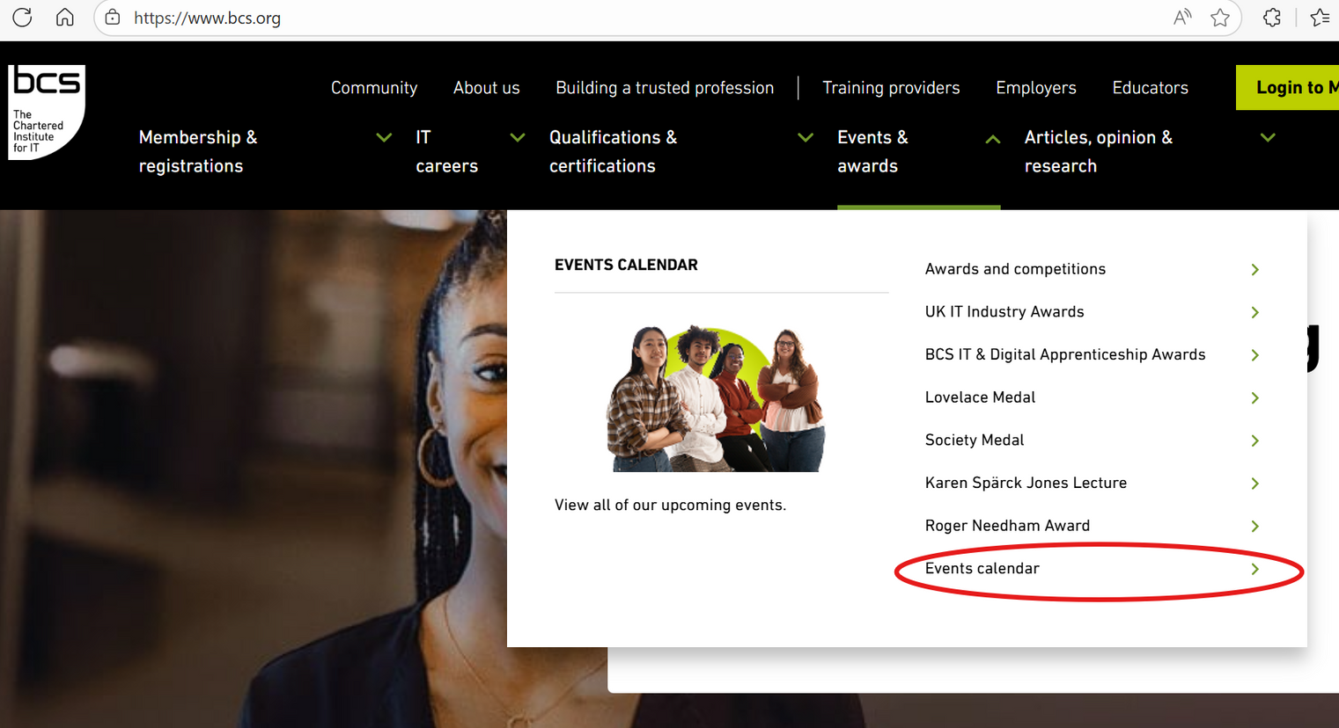
Professional Bodies
Notes:
RICS provides career pathway advice as well as a jobs board for the industry
16

Slide 24
Developing your work ready toolkit
Recruitment and selection processes vary from business to business - it is worth starting to develop your knowledge early, so you have plenty of time to practice. Visit the Careers website to access support with​
​
CV, cover letter and application forms​ ​
How to create a great LinkedIn Profile​ ​
Interview Techniques ​ ​
Psychometric tests and Assessment Centres ​
​
Attend Career-promoted events and book to see us for more help and support.

Slide 25
CURRENT PLACEMENT!

Slide 26
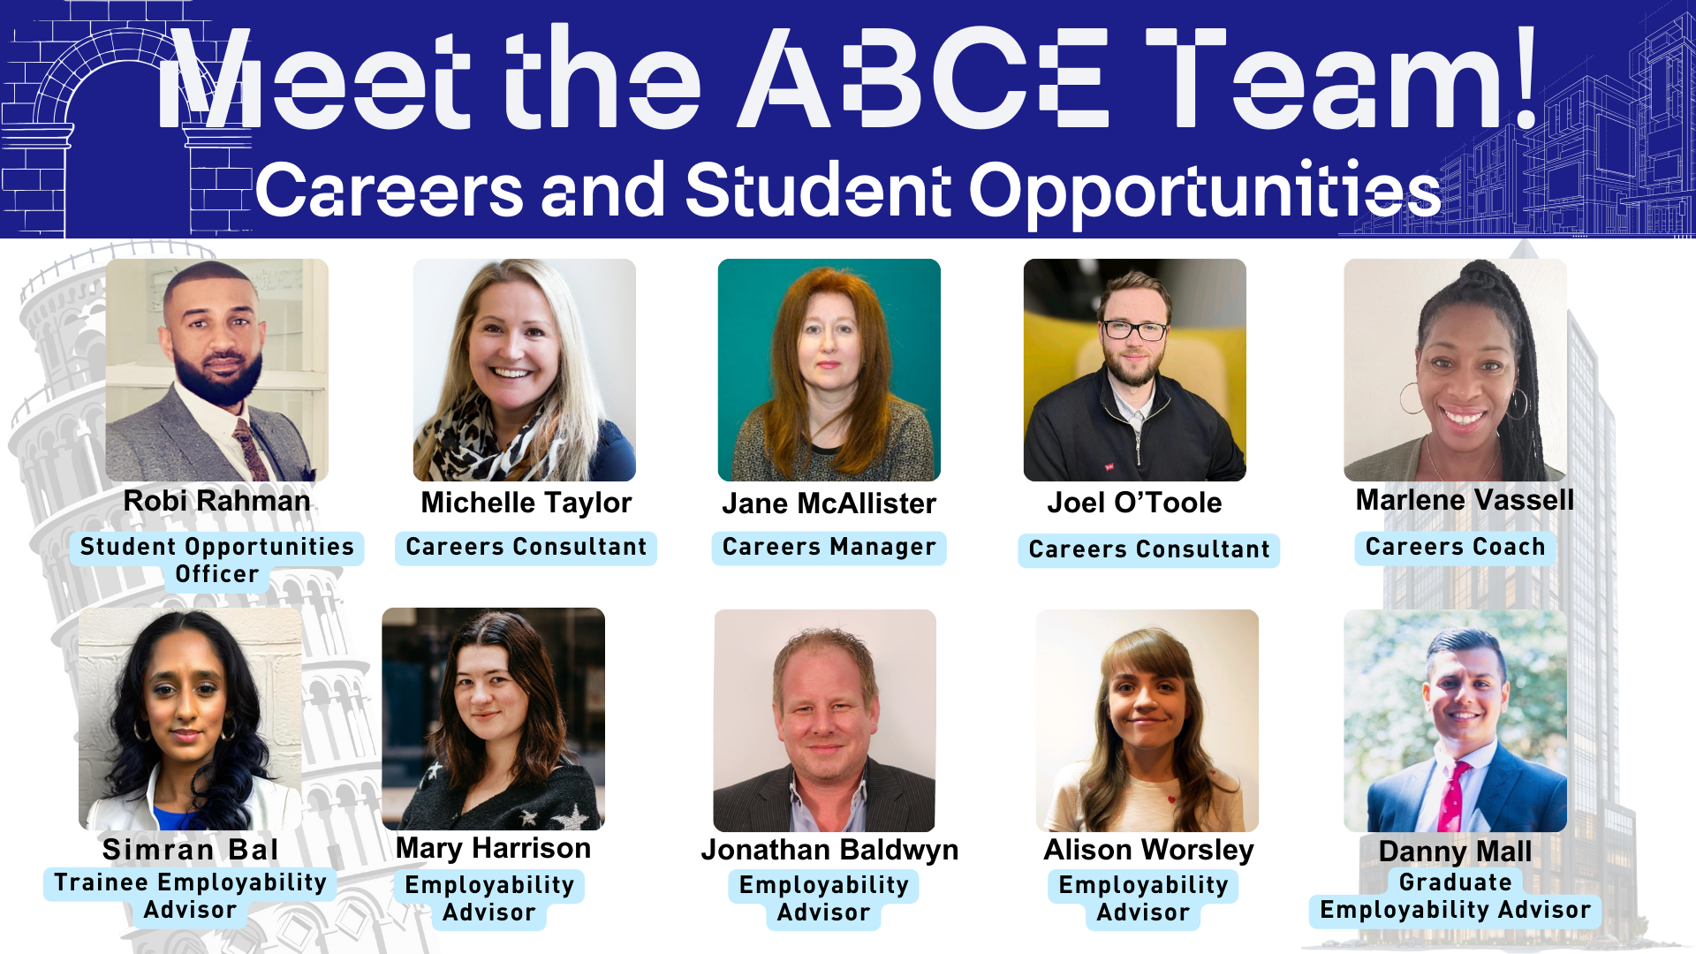

Slide 27
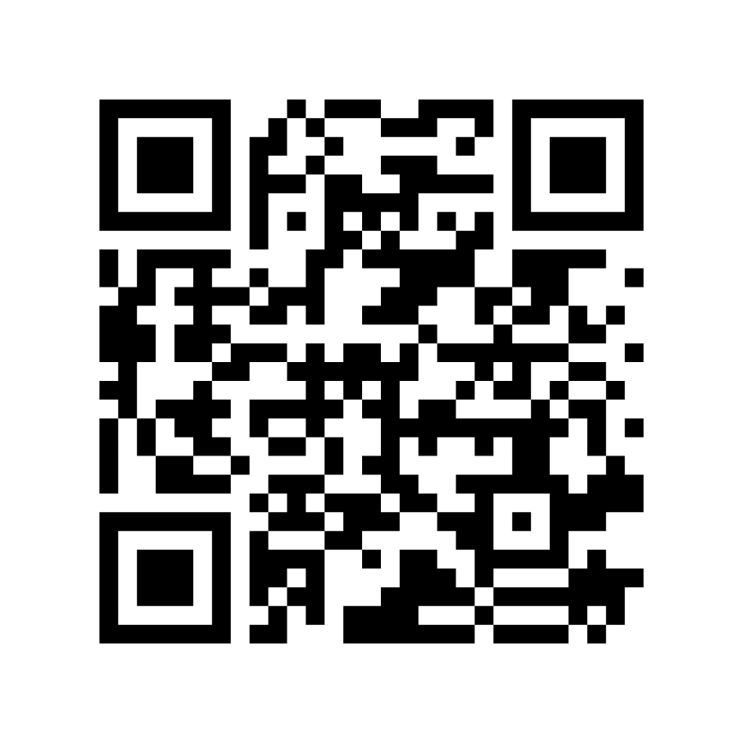

Tell us what you think

Slide 28


Develop your understanding of the sector
Attending virtual recruitment fairs
Checking out job profiles on student career sites such as Prospects, All About Careers, iCould, Target Jobs
Work experience / Placements
Work shadowing
Reading job adverts
Checking out company websites
Talking to your course tutor
Reading industry journals
Getting insights from people you know who work in those fields
Finding out what graduates of your degree have gone on to do
Finding a mentor

Slide 29
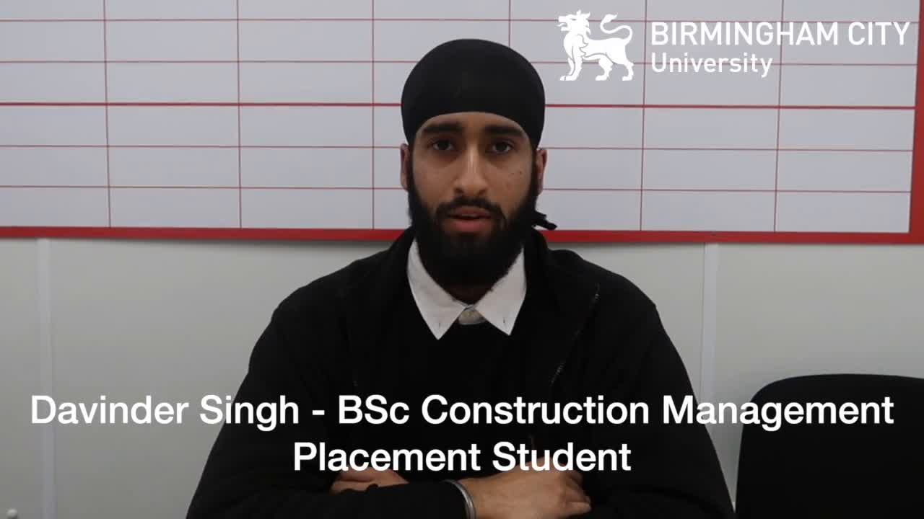
Year-long Placements

Slide 30










Finding a part-time job
Help
avaliable...

Slide 31
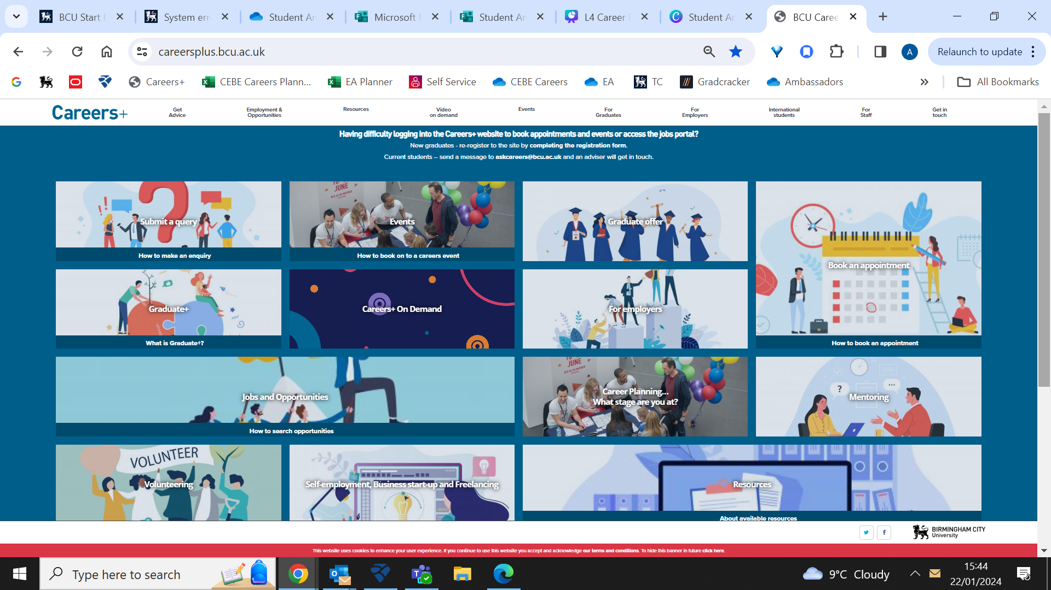
Preparation Resources: Careers+ website

